Slide 1



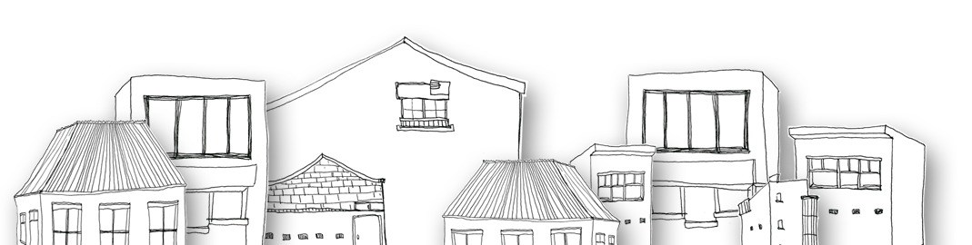


HOTEL RESERVATION SYSTEM

Slide 2


Objective
To develop a comprehensive hotel reservation system that manages room availability, bookings, and associated customer data. The system includes GUI integration for user interaction and implements a robust database schema to ensure data consistency, scalability, and ease of retrieval.

Slide 3

Tools Used
The tools used in the development of the project “HOTEL RESERVATION SYSTEM” are:
My SQL (DATABASE)
VS Code (GUI)

Slide 4



Introduction
The Hotel Reservation System is a desktop application designed for hotels to efficiently manage their operations, including room bookings, check-In, Check-Out customer details, and financial calculations. The system:
Ensures accurate record-keeping of rooms and reservations in real time.
Facilitates room availability checks and other features like room bookings, check-in, check-out and booking cancellation.
Allows staff to perform key operations such as booking, updating, and canceling reservations.
Maintains consistent and reliable booking records and provides a user-friendly GUI to interact with the database.
The back-end database is implemented using my SQL and interacts seamlessly with the Java-based GUI.

Slide 5

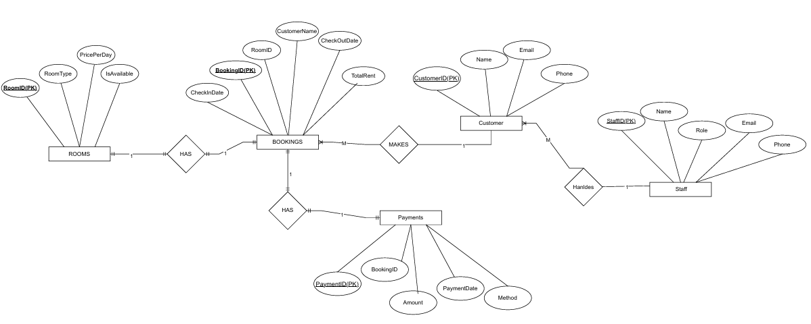
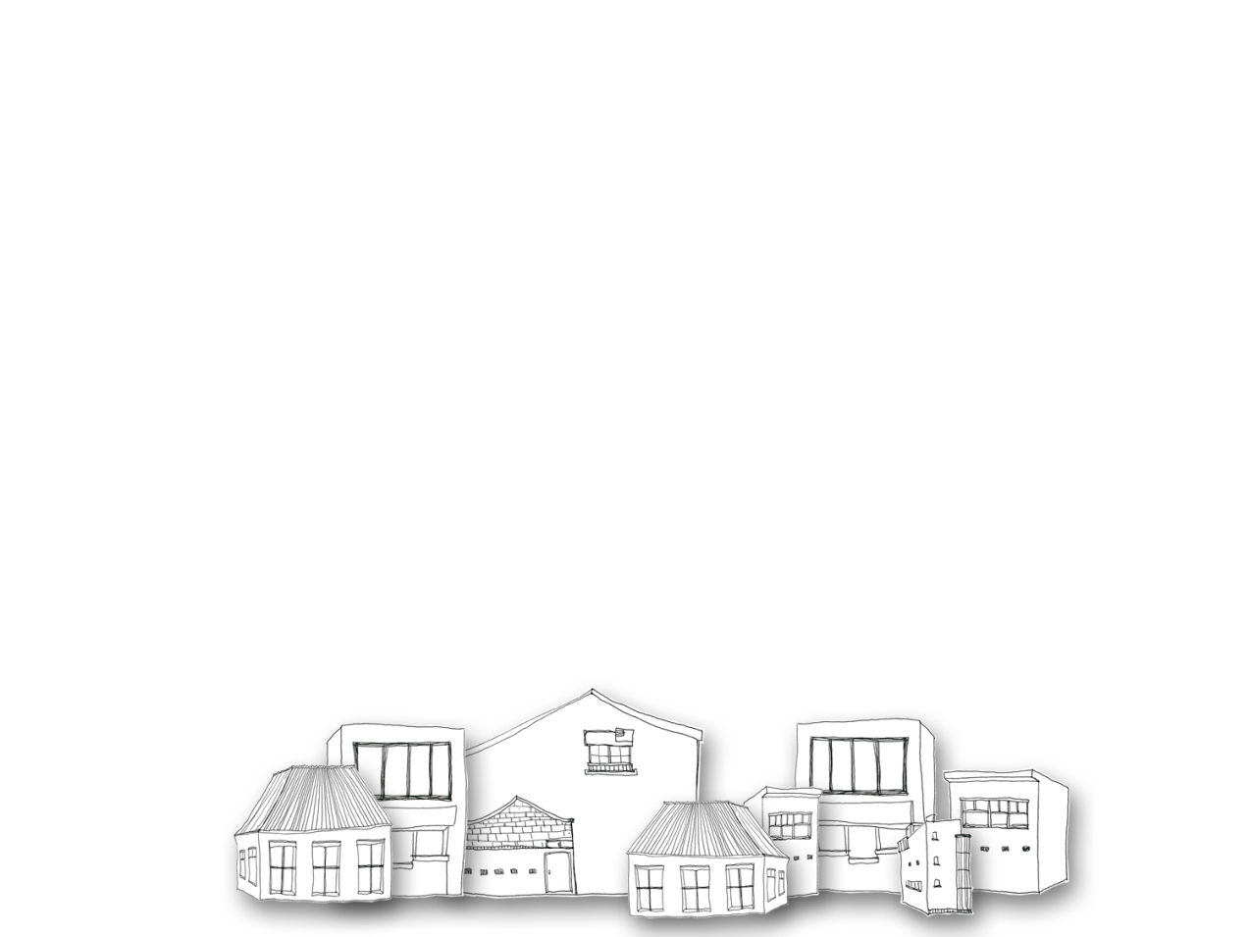
Entity Relationship Diagram (ERD)
An Entity-Relationship Diagram (ERD) to represent entities such as Rooms, Bookings, and Customers.

Slide 6

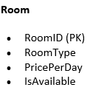
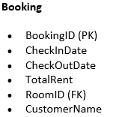
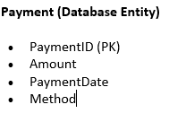
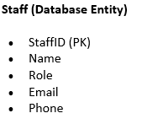
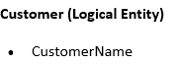
Database Normalization
The database is normalized up to Third Normal Form (3NF) to reduce redundancy and maintain data integrity.
Normalized Tables:
Rooms
Bookings
Customers
Payments
Staff

Slide 7



GUI Interface
Java GUI includes functionalities of:
Viewing room availability with real time checks.
Adding, updating, viewing and deleting bookings.
Automatically calculates rents based on stay duration.
Allows updating room prices and modifying checkout dates.
.

Slide 8
Database Queries Used In GUI code

Slide 9
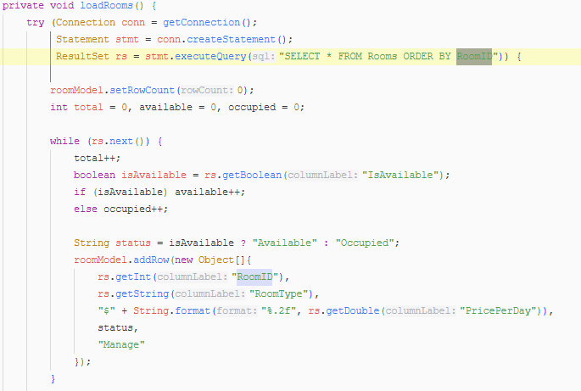
Retrieve All Rooms
Database Query Used:
SELECT * FROM Rooms
ORDER BY RoomID;

Slide 10

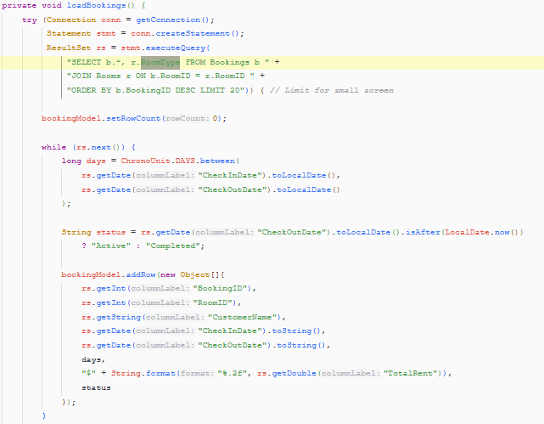
Retrieve Booking
Records
Query Used:
SELECT * FROM Bookings;
SELECT b.*, r.RoomType
FROM Bookings b
JOIN Rooms r ON b.RoomID = r.RoomID;
ORDER BY b.BookingID DESC LIMIT 20

Slide 11


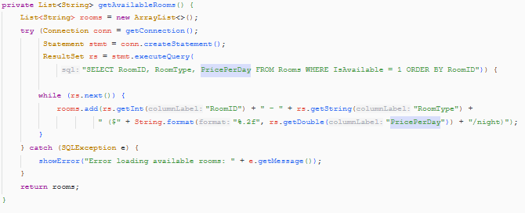
Retrieve Available Rooms for Booking
Database Queries Used:
SELECT RoomID, RoomType, PricePerDay
FROM Rooms
WHERE IsAvailable = 1
ORDER BY RoomID;

Slide 12

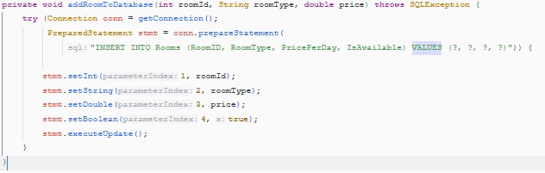
Insert New Booking
Record
Query Used:
INSERT INTO Bookings
(RoomID, CustomerName, CheckInDate, CheckOutDate, TotalRent)
VALUES (?, ?, ?, ?, ?);

Slide 13

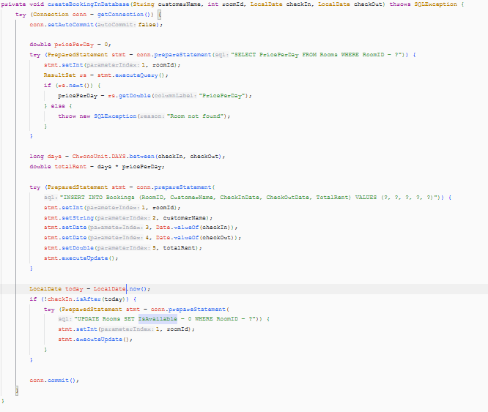
Update Room Availability on Check-In
Query Used:
UPDATE Rooms
SET IsAvailable = 0
WHERE RoomID = ?;
SELECT PricePerDay FROM Rooms
WHERE RoomID = ?

Slide 14
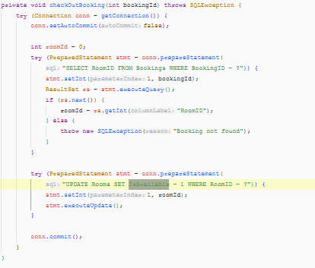
Update Room Availability on Check-Out or Cancellation
Query Used:
UPDATE Rooms
SET IsAvailable = 1
WHERE RoomID = ?;

Slide 15
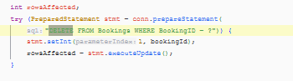
8. Delete Booking Record
Database Queries Used:
DELETE FROM Bookings
WHERE BookingID = ?;

Slide 16
Dashboard Statistical Queries
Total Rooms
SELECT COUNT(*) FROM Rooms;
Available Rooms
SELECT COUNT(*) FROM Rooms WHERE IsAvailable = 1;
Occupied Rooms
SELECT COUNT(*) FROM Rooms WHERE IsAvailable = 0;
Active Bookings
SELECT COUNT(*)
FROM Bookings
WHERE CheckInDate <= CURDATE()
AND CheckOutDate >= CURDATE();

Slide 17
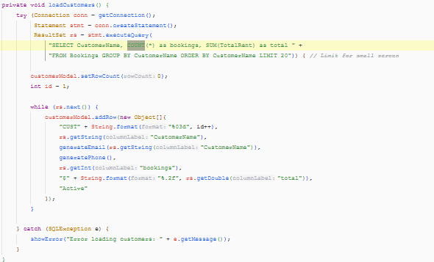
Customer Summary
Query
SQL Query
SELECT CustomerName, COUNT(*) AS bookings, SUM(TotalRent) AS total
FROM Bookings
GROUP BY CustomerName;

Slide 18
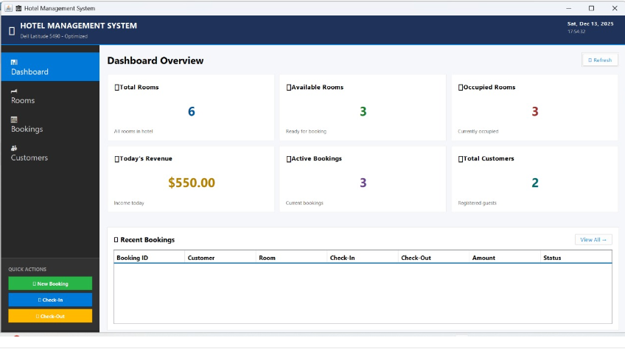
Dashboard

Slide 19
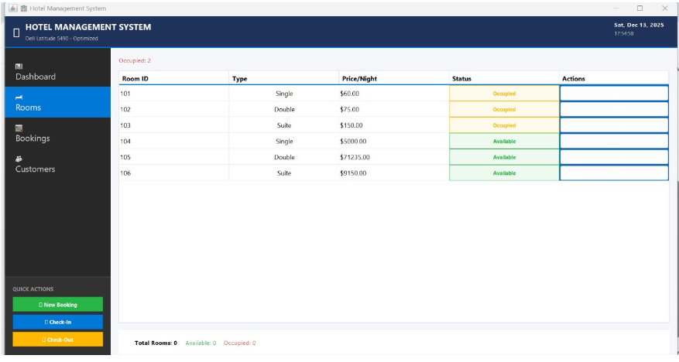
Rooms

Slide 20
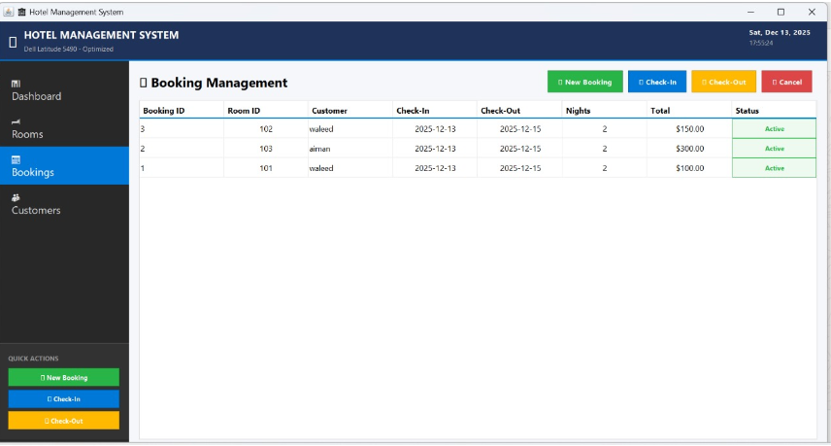
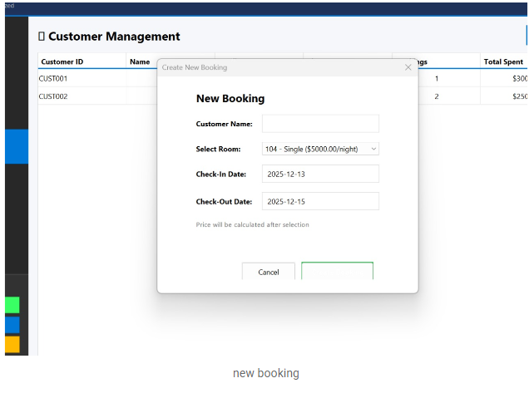
Bookings
Add New Bookings

Slide 21
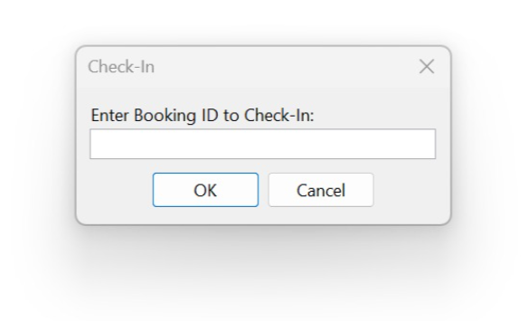
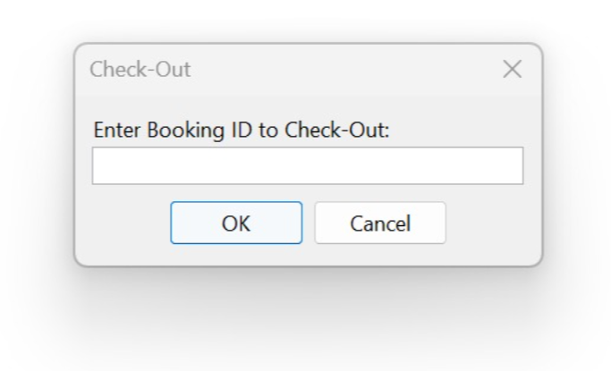
Check-In
Check-Out

Slide 22
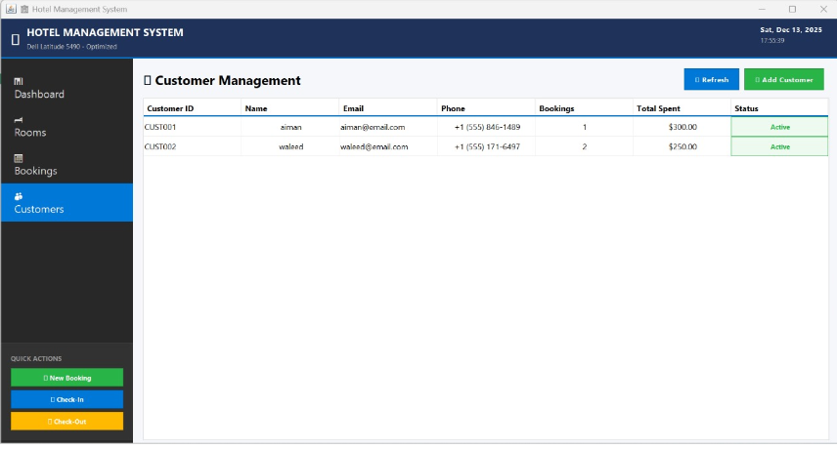
Customers

Slide 23
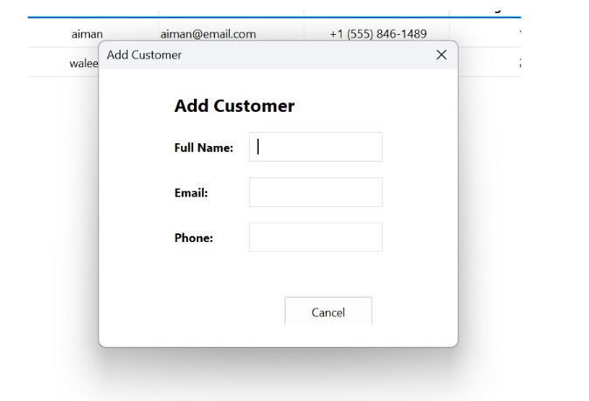
Add Customers

Slide 24
Conclusion
The Hotel Reservation System successfully demonstrates the
practical application of DBMS concepts such as normalization,
entity relationships, business rules, and CRUD operations.
By integrating a GUI with a relational database, the system provides an efficient and reliable
solution for hotel reservation management.

